Slide 1
SMART HOSPITAL SYSTEM
A Web Portal for Hospital Management
PRESENTED BY
MD. SARWAR UL ISLAM - C143046
MD. RAYHAN MAHMUD - C143047
KAZI MD. SAIFUL ARFIN - C143050
SUPERVISED BY
MR. MOHAMMAD MAHADI HASAN
ASSOCIATE PROFESSOR
DEPT. OF CSE, IIUC.

Slide 2
OUTLINE
Introduction
Motivation
Objective
Previous Works
Advantages
Methodology
Requirements
Diagrams
Implementation
Limitation
Future Scope
Conclusion

Slide 3
Introduction
Public health Care and modernization of Hospital management system
A robust management system architecture is mandatory. The rapid rise of Internet of things has provided a new way of thinking with a lots of new ideas.
The revolutions of automation provides a strong platform to develop the hospital’s information management
Inefficiency of existing system.
Smart Hospital System: A solution.
A robust health care and hospital system: Advantages of modern web technology.

Slide 4
Motivation
Health care sector is a daunting challenge area for us.
If it is not managed properly it can result in chaos and more importantly it even can lead to death of human lives.
For the sophisticated nature we wanted to contribute to this sector with skills we have acquired.
Smart Hospital System is the first step towards this approach through which we have tried to make a robust system for managing every section of a hospital.

Slide 5
Objective
Design a system for better patient care.
Reduce hospital operating costs and time.
Better co-ordination among different departments in a hospital
Provide real time information which is needed anytime and anywhere.
Improve the relation between patient and hospital organization.

Slide 6
Previous Work
The current system requires numerous paper forms, with data stores spread throughout the hospital management infrastructure.
The information is very difficult to retrieve and to find particular information like- E.g. - To find out about the patient’s history, the user has to go through various registers.
The information generated by various transactions takes time and efforts to be stored at right place
Forms are often lost in transit between departments requiring a comprehensive auditing process to ensure that no vital information is lost.

Slide 7
CSCR
No online appointment system
No online appointment system
No messaging option for Doctor and patient
Epic HC
No online appointment system
National Hospital
No online appointment system
No messaging option for Doctor and patient
No online bed allotment system,
Chevron
No online bed allotment system,
No messaging option for Doctor and patient
No online bed allotment system,
No messaging option for Doctor and patient
No online bed allotment system,

Slide 8
Advantages of our system
All the operations like searching, bed allotment, patient management, billings and other related things are automated which leads to saving time and effort.
It provides real time information which is needed anytime and anywhere.
Reduces the manpower needed for controlling the present system and to provide the best efficiency.
Streamlining communication-Both doctor and patient can communicate easily by this system.
Getting Appointment of a doctor is easier in our system.
History of patients are live here.

Slide 9
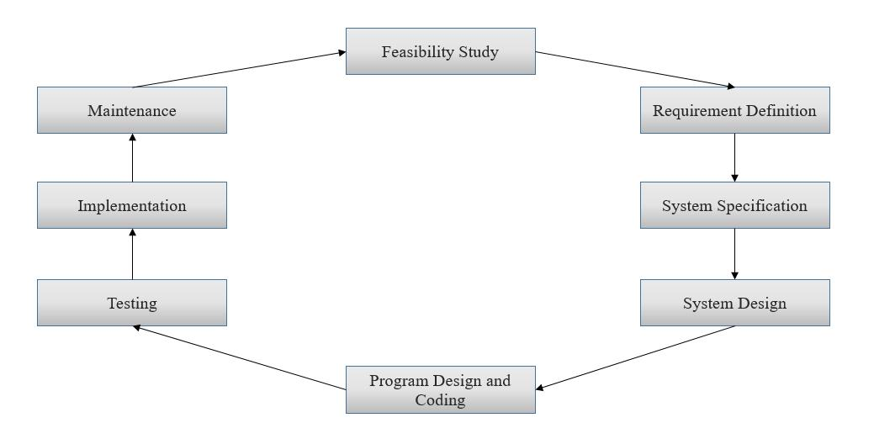
Methodology
For Smart Hospital System, we follow SDLC to make specific for the user.

Slide 10
We will apply Waterfall Model for this project
It is very simple to understand and use
Each phase must be completed fully before the next phase can begin.
At the end of each phase, a review takes place to determine if the project is on the right path and whether or not to continue or discard the project.
In this model the testing starts only after the development is complete.
Phases do not overlap.

Slide 11
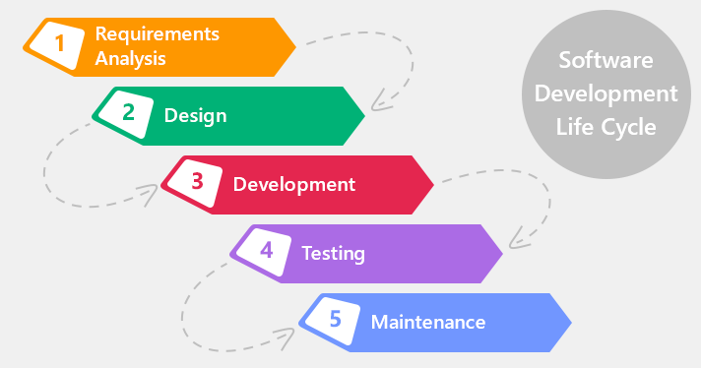
Waterfall Model

Slide 12
System Tools
Front-End Tools
HTML5
CSS3
Javascript
Bootstrap
Jquery
Back-End Tools
PHP Code igniter
Database
MySql

Slide 13
Requirement for This System
Computer/Laptop/Smart phone
Web Server
Latest Browsers Like Chrome, Mozilla Firefox etc.
Internet Connection

Slide 14
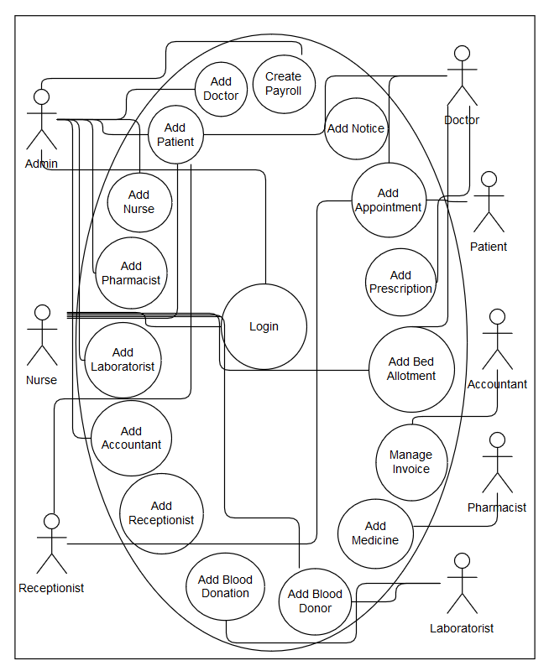
Use Case Diagram

Slide 15
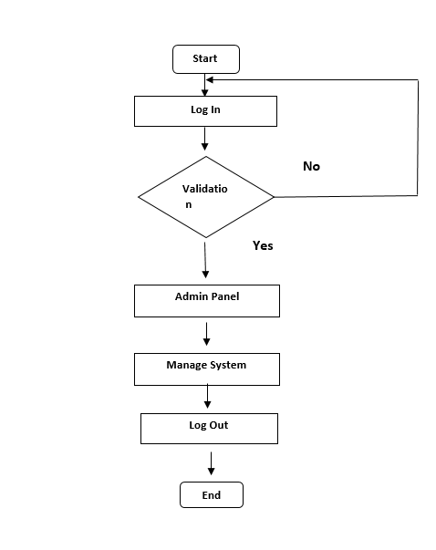
Flow Chart for Admin

Slide 16
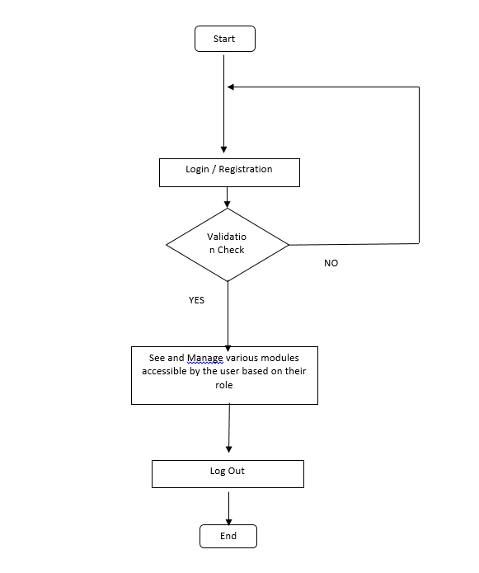
Flow Chart for user

Slide 17
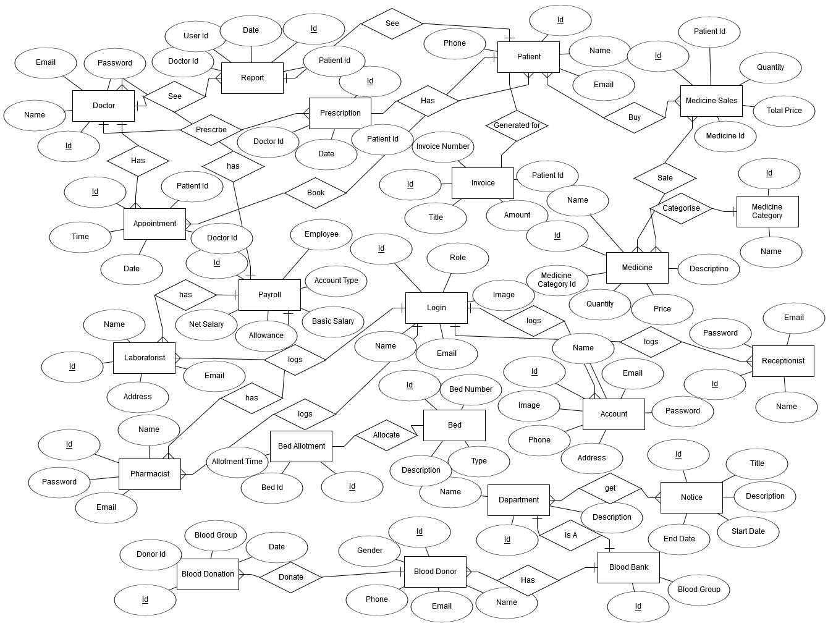
ER Diagram

Slide 18
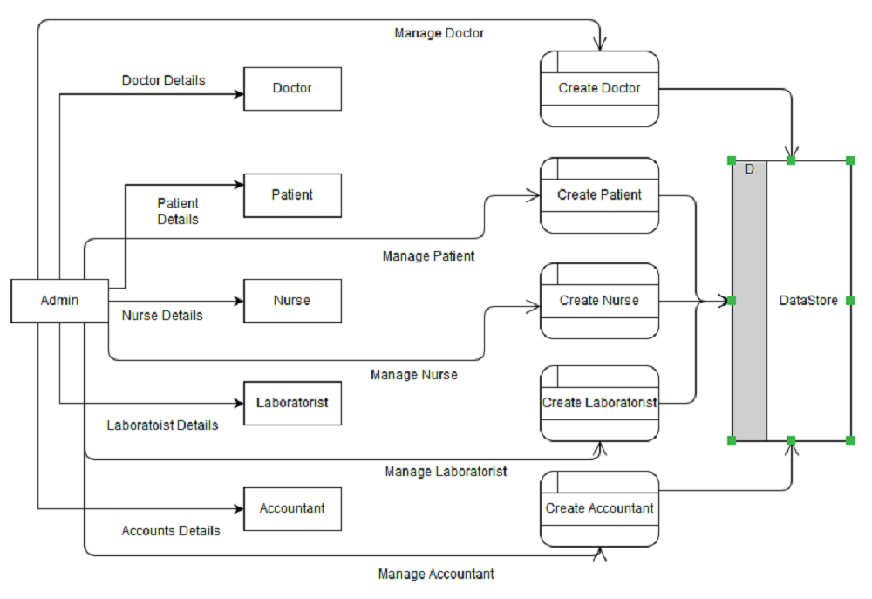
Data Flow Diagram
O Level DFD

Slide 19
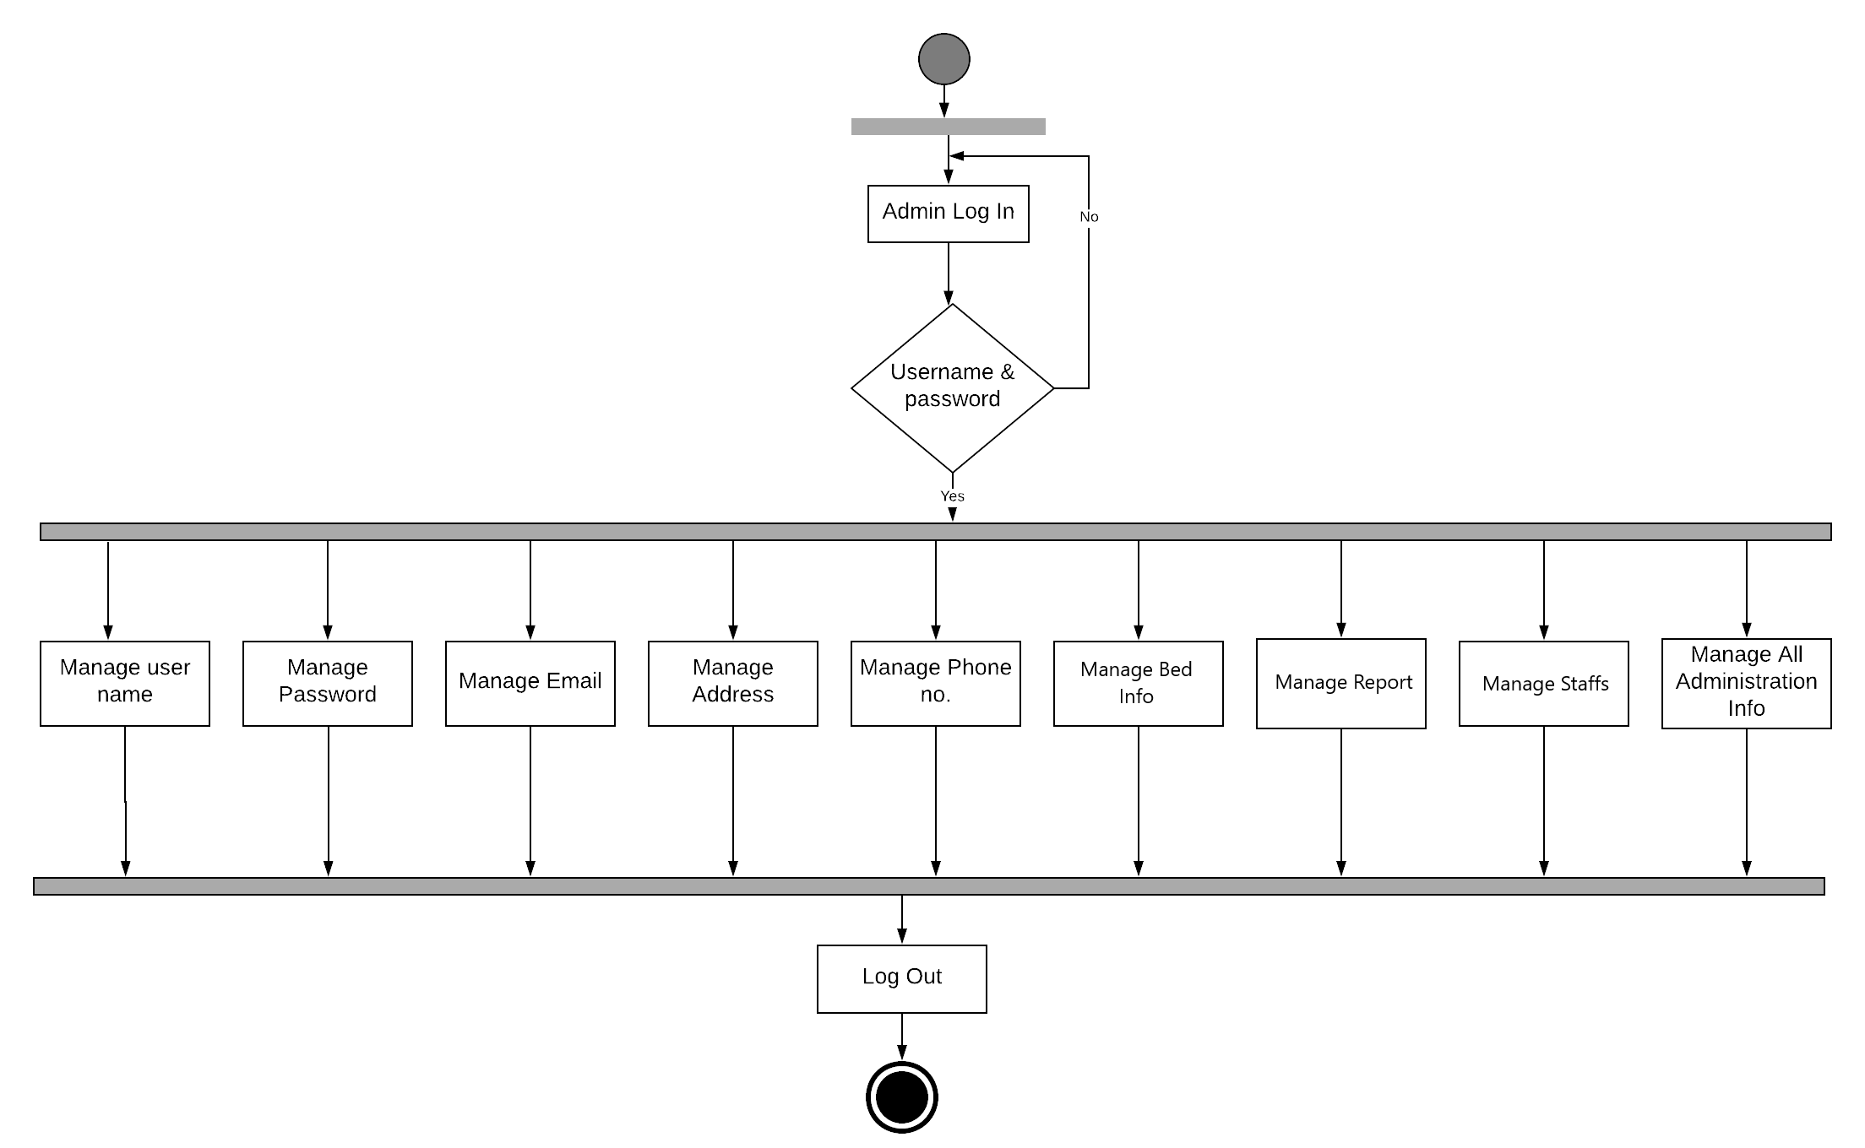
Activity Diagram of Admin

Slide 20
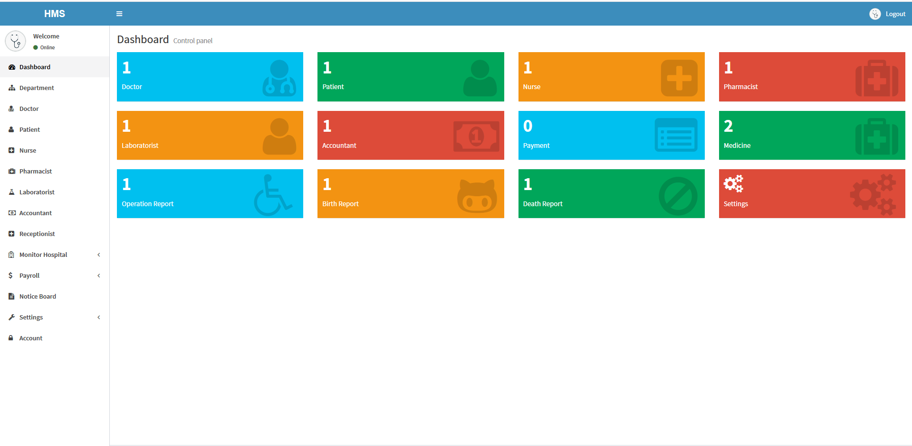
Smart Hospital System UI
Admin Dashboard

Slide 21
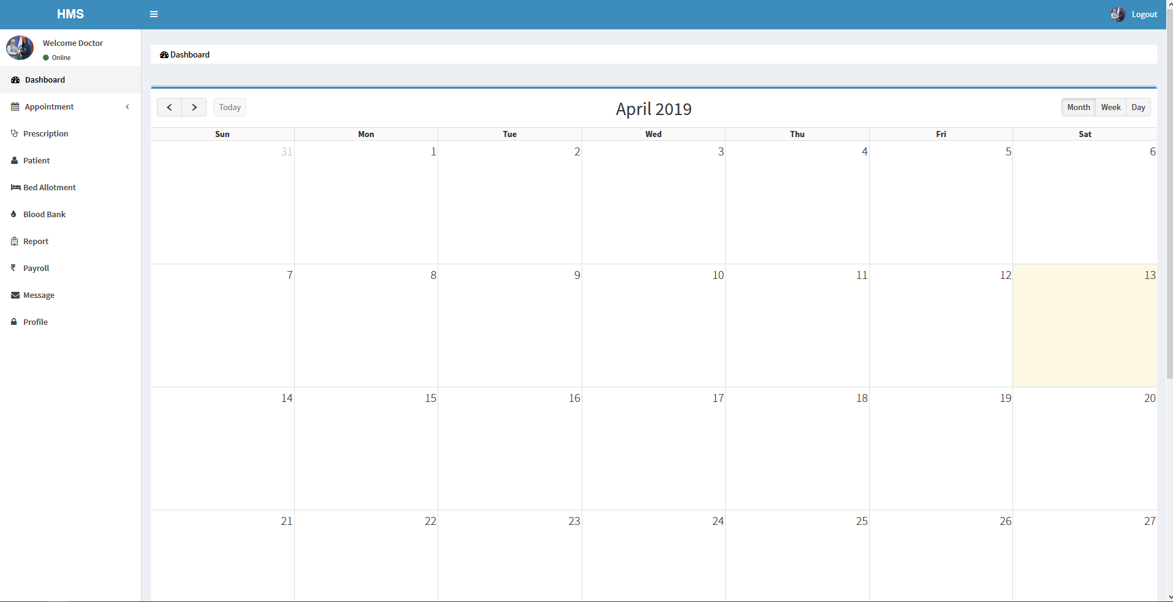
Doctor Dashboard

Slide 22
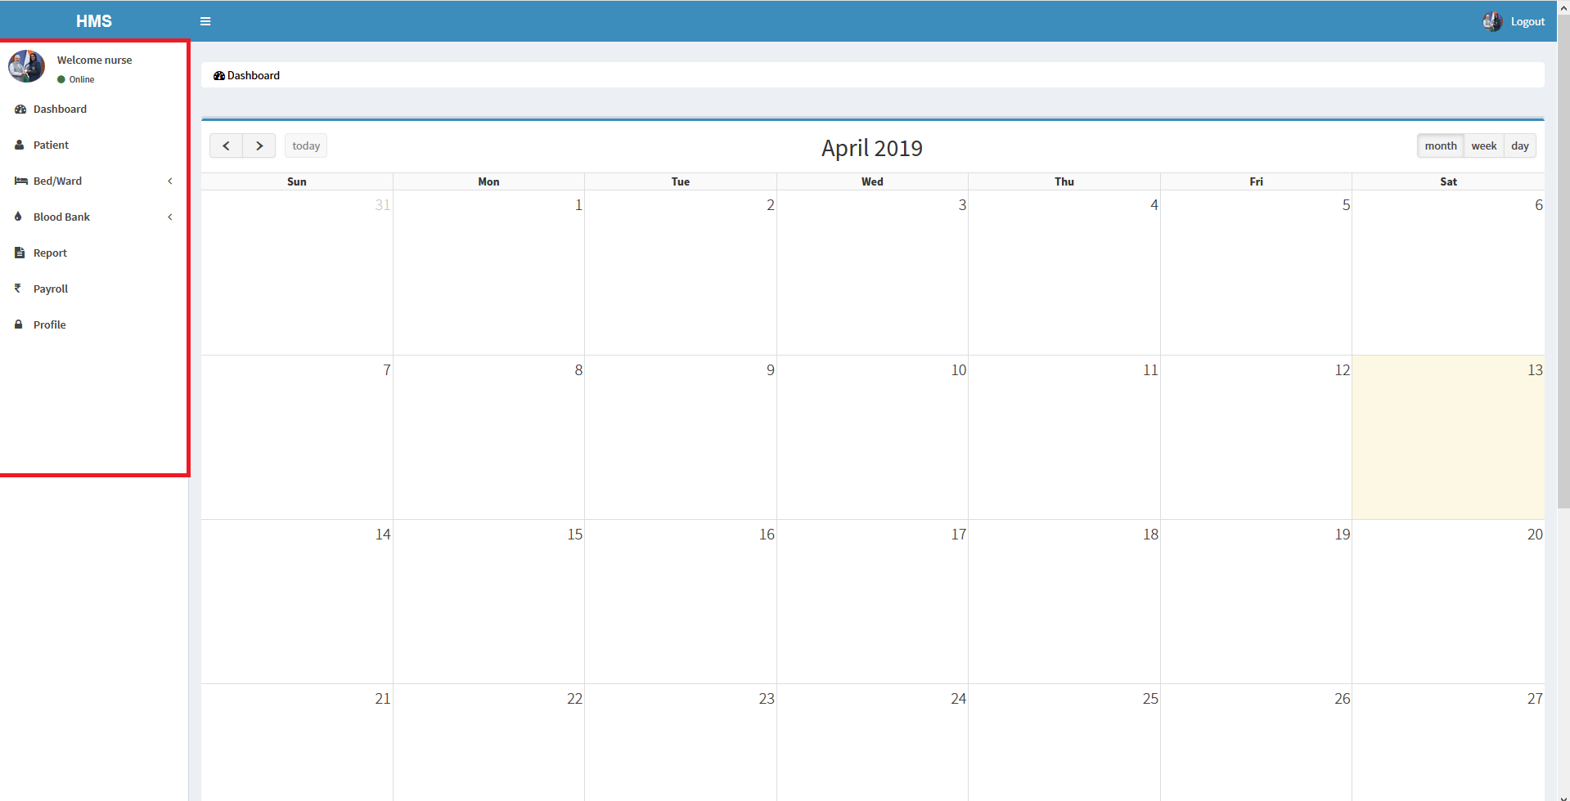
Nurse Dashboard

Slide 23
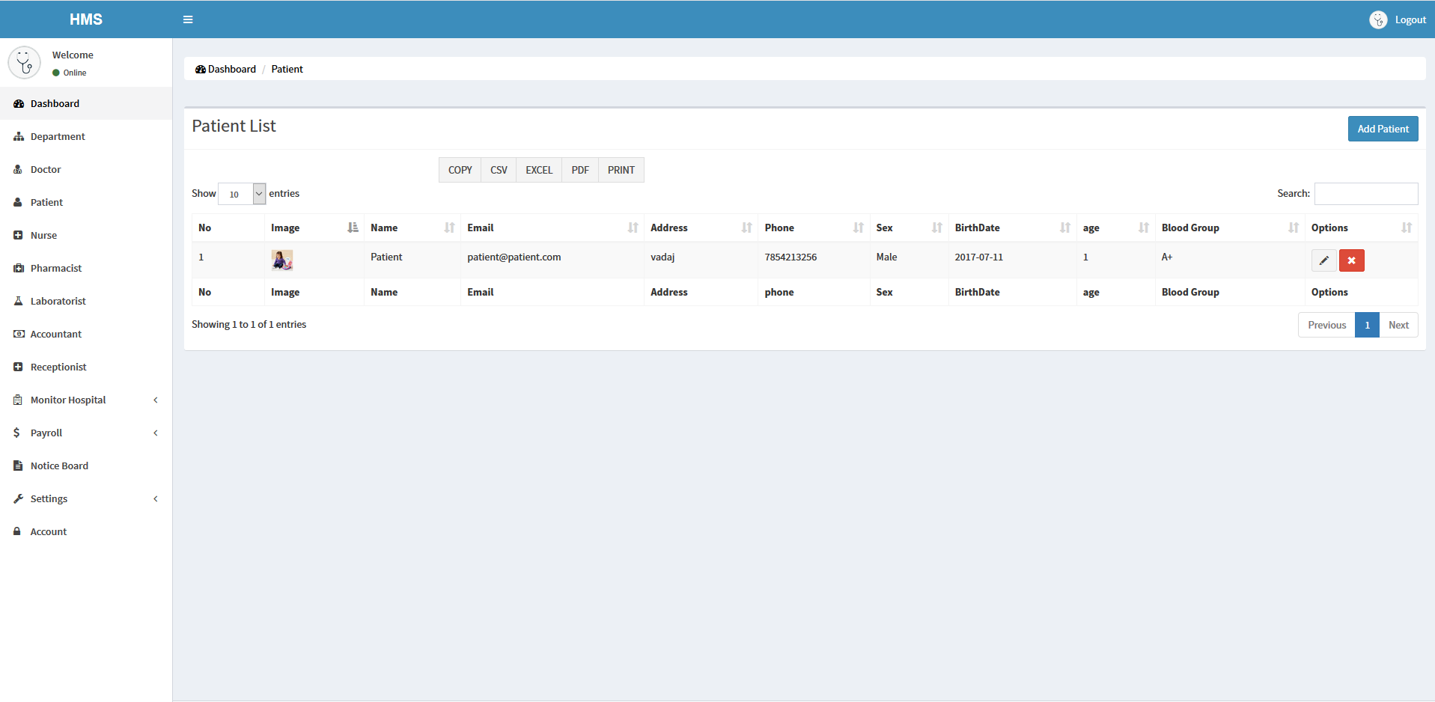
Patient List

Slide 24
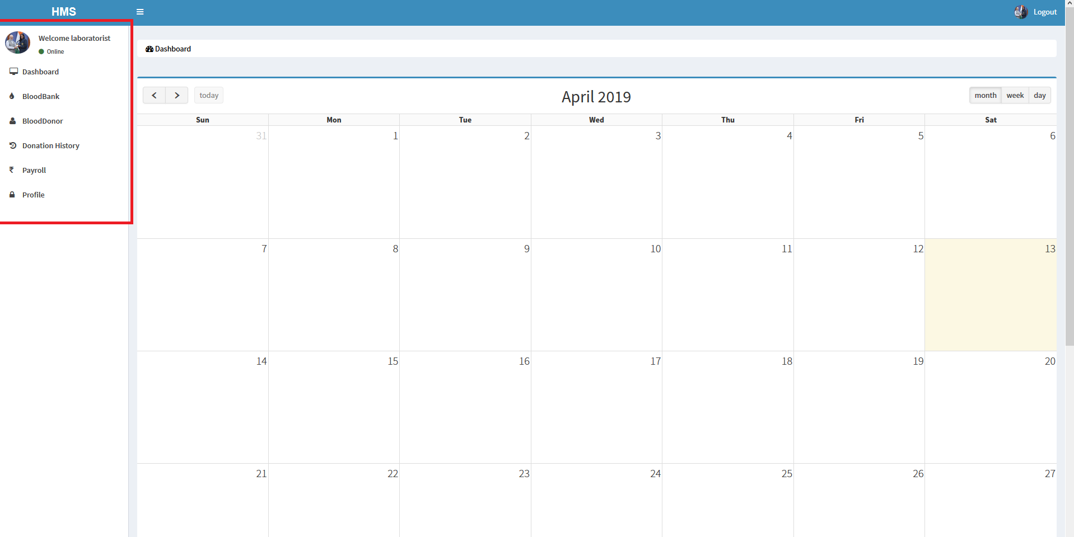
Laboratories Dashboard

Slide 25
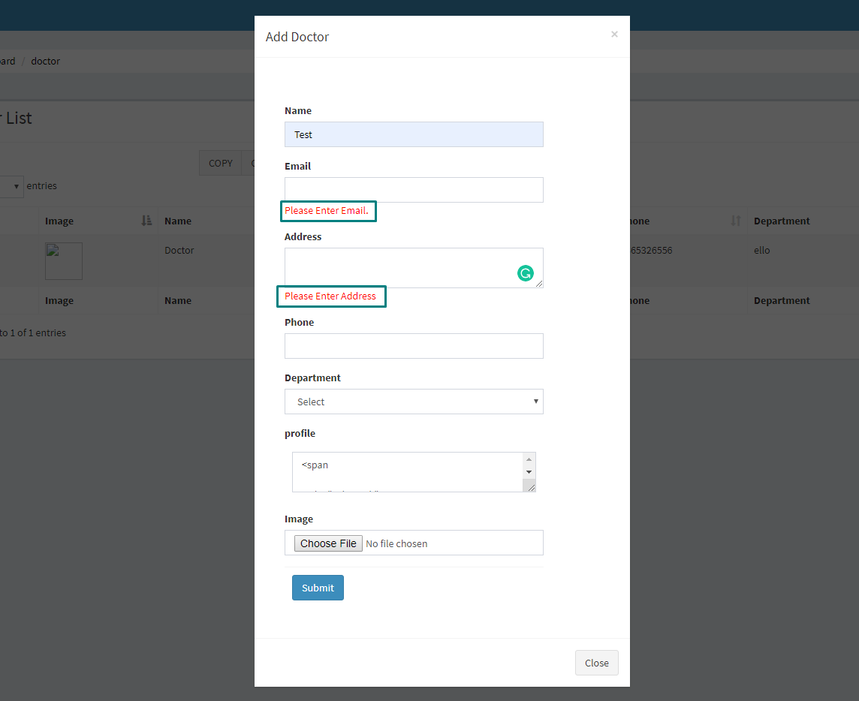
TESTING
White Box Testing In Our System

Slide 26
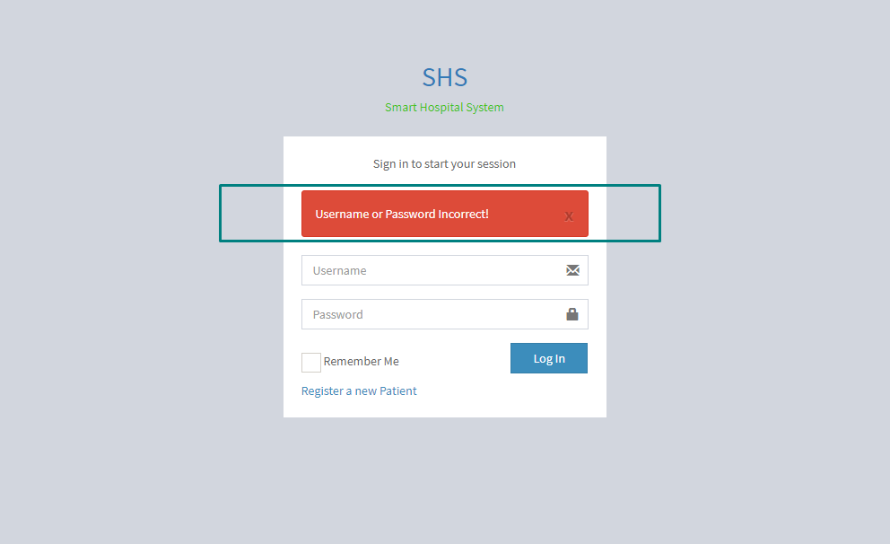
Black Box Testing In Our System

Slide 27
Limitation
No mobile application of the system has been made.
The system has no emergency module.
Pathological services are not included here.

Slide 28
Future works
Some of the future work of the project are below there:
We will directly make deals for different hospitals.
Mobile application will be introduced.
Every kind of information about the hospital through SMS.
Electronic Health records will be used.
We will make this application for international purpose.

Slide 29
Conclusion
In this system we tried our best to make the system very robust and easy to use.
Using this project a hospital can easily maintain their Internal System efficiently.
This system can increase interaction between doctor and patients.

Slide 30
References
[1]. Roberta M. Roth, Barbara Haley Wixom, Alan Dennis, “System Analysis and Design”, 5th Edition 2012
[2]. Tim Converse,Joyce Park,Clark Morgan, “PHP7 and MySQL Bible”,Wiley publishing,INC. [3]. https://en.wikipedia.org/wiki/Hospital_information_system ,’Hospital information system’………………………………….. [visited: 3.02.2019]
[4].https://www.youtube.com/watch?v=jnjjzATOgIM&list=PLh89M5lS1CIATULcdS4UHx9pj3GGW8nNM, ‘Codeigniter Beginner Tutorial’……………………………………………………[visited:7.01.2019]

Slide 31


